Slide 1
MS Teams Meet Summarizer
Internship Project Presentation
Presented by: Debi Prasad Jena(121EC0276)
Organization: Genpact

Slide 2
Problem Statement
Lengthy MS Teams meetings are hard to review.
Users want quick and accurate summaries.
Manual summarization is time-consuming and inefficient.
Need for an automated, user-friendly summarization tool.

Slide 3
Project Overview
Users upload video (.mp4) and transcript (.docx) of the Teams meeting.
System processes and summarizes the meeting
Outputs a downloadable summary (.docx)
Real-time task progress during the processing of the file
Develop and deploy the application in a Distributed System

Slide 4
Technology Stack
Frontend: React
Backend: FastAPI (User Service & Video Service)
Database: PostgreSQL (User & Meet models)
Queue: Redis + Celery
Storage: Azure Blob Storage
AI Model: Azure OpenAI via LangChain
Deployment: Kubernetes(Docker Container)

Slide 5
User Service
Developed using FastAPI and PostgreSQL as a Database
It has Login, SignUp, get all meetings, and upload meeting api endpoints
Handles JWT authentication, file upload
Stores user and meeting data in PostgreSQL
Uploads video/transcript to Azure Blob
Sends unique file names to Video Service via Celery + Redis
Streams real-time progress updates via Redis Stream to User

Slide 6
Video Service
Downloads files from Azure storage using the file names from the user service.
Chunk transcript files using LangChain
Summarizes using the Azure OpenAI model
Extract unique video frames and attach them to the respective timestamp duration of the summary.
Converts the result to a Word document
Uploads summary to Azure blob storage
Push task progress message to Redis stream.
User Service picks up the message and streams progress to the client
When the message is 100 percent completed, User service stores the results in the Database

Slide 7
Database Design
User Model: user_id(PK),name, email,password
Meet Model: meet_id, user_id (FK), title, date, organizer, duration, transcript_url, summary_url
Efficient tracking and storage of meeting data

Slide 8
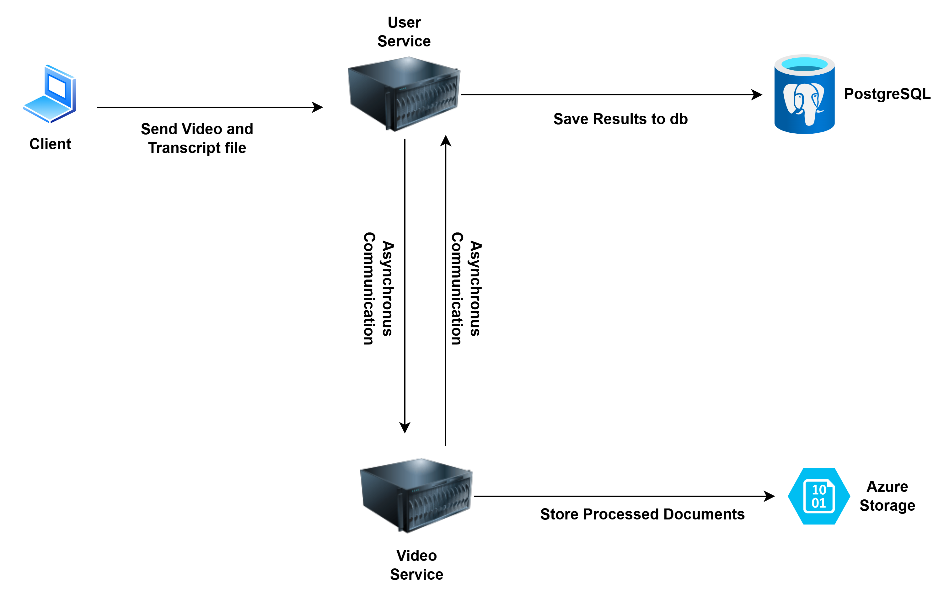
System Architecture
Overall System Design

Slide 9
Real-Time Task Progress
Redis Stream used for messaging
Video Service pushes processing updates
User Service listens and forwards to the frontend via EventSource
Improves user experience with live status

Slide 10
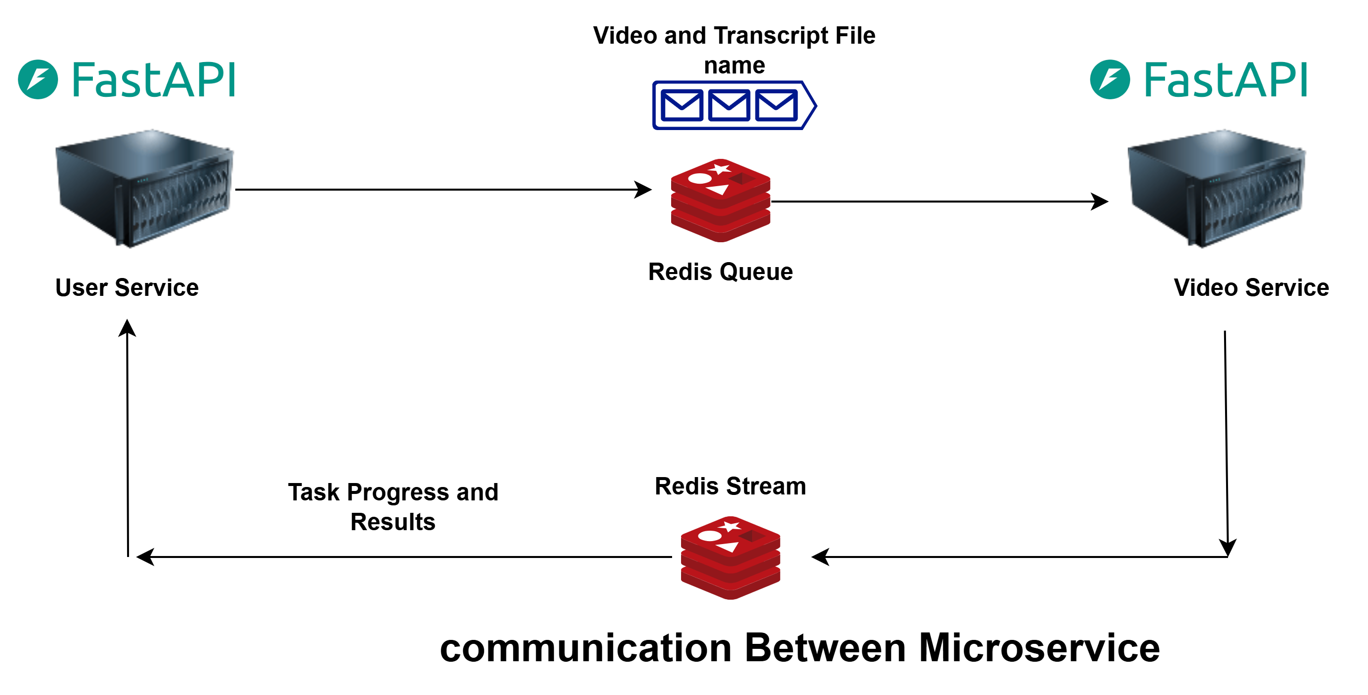
System Architecture

Slide 11
Deployment and Scalability
Services to be containerized using Docker
To be deployed on a Kubernetes Cluster
Supports auto-scaling and load balancing
Prepares system for production-level traffic

Slide 12
Results and Discussion
The MS Teams Meet Summarizer system successfully processes meeting videos and transcripts to produce concise and readable summaries. Users can upload both files seamlessly through the React frontend, and the backend handles the entire pipeline asynchronously without blocking the user interface.
Key results observed during testing:
Average processing time for a 1-hour meeting transcript: ~2–3 minutes.
Accuracy and coherence of summaries were high, with well-structured points extracted using Azure OpenAI models.
Real-time progress updates provided a smooth user experience, reducing uncertainty during long-running tasks.
System handled concurrent requests without significant performance degradation, thanks to Celery and Redis-based task distribution.

Slide 13
Conclusion & Learnings
Gained experience in microservices architecture
Worked with cloud platforms, Redis, Celery, and LangChain
Improved backend development and deployment skills

Slide 14
THANK YOU

